Slide 1

C Programming Project Presentation
Project Title: [Matrix Operations Tool]
Course: C Programming Lab / Mini Project
Department: Computer Science
Team 4
GUKANESH C
GURUPRASATH A M
HEMAVARSHINI K
HEMA HARSHITHA V
JANARTHANAN C

Slide 2
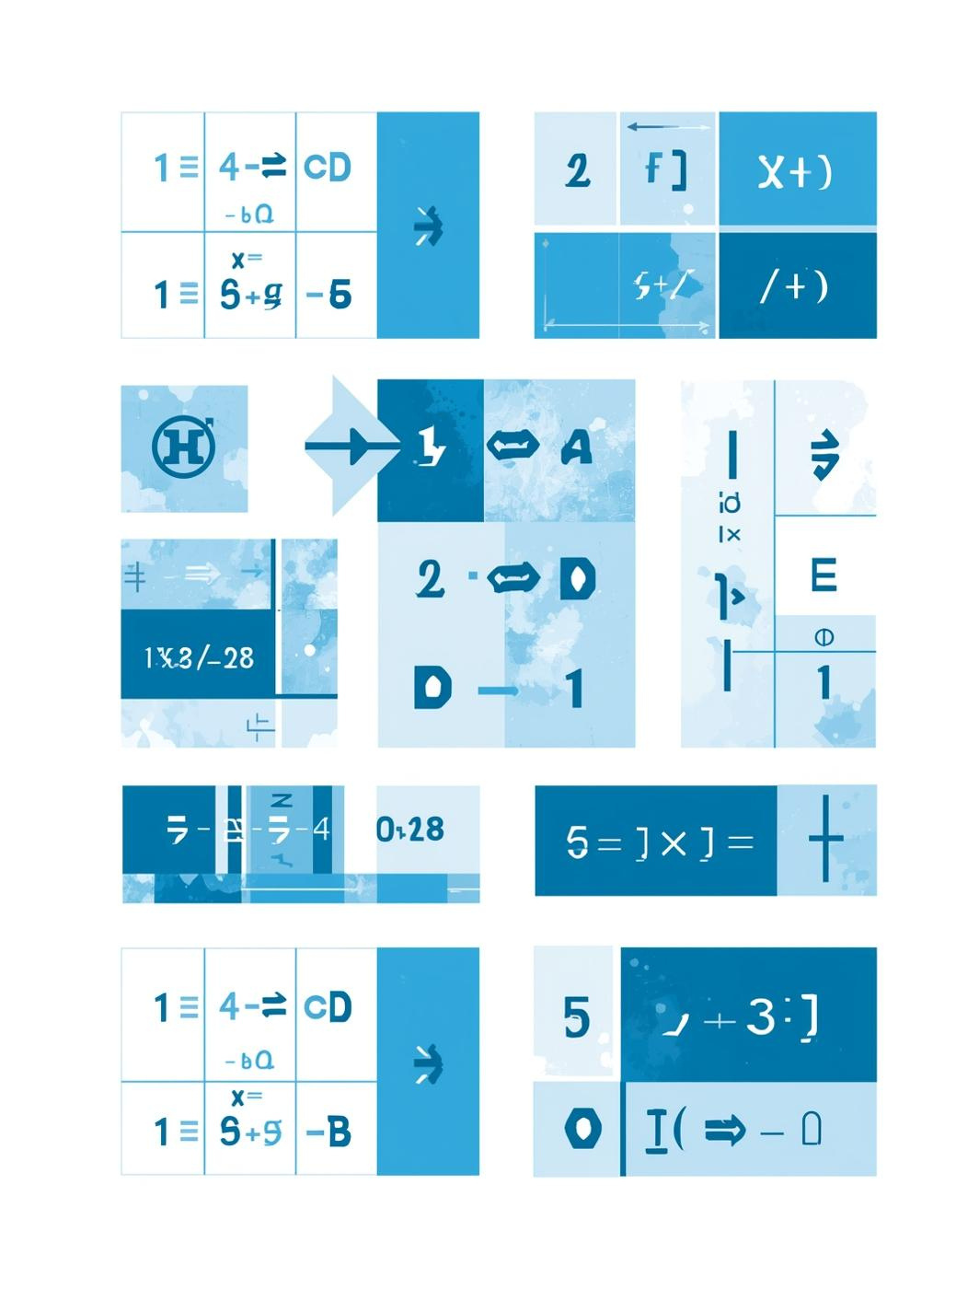

Introduction
The Importance of Automating Matrix Calculations in C Programming
Automating matrix computations significantly enhances efficiency and accuracy in mathematical operations. This project demonstrates how to leverage C programming to facilitate essential matrix functions such as addition, subtraction, multiplication, and transposition. A user-friendly interface ensures that users can perform these operations seamlessly, reducing manual errors and saving time.

Slide 3




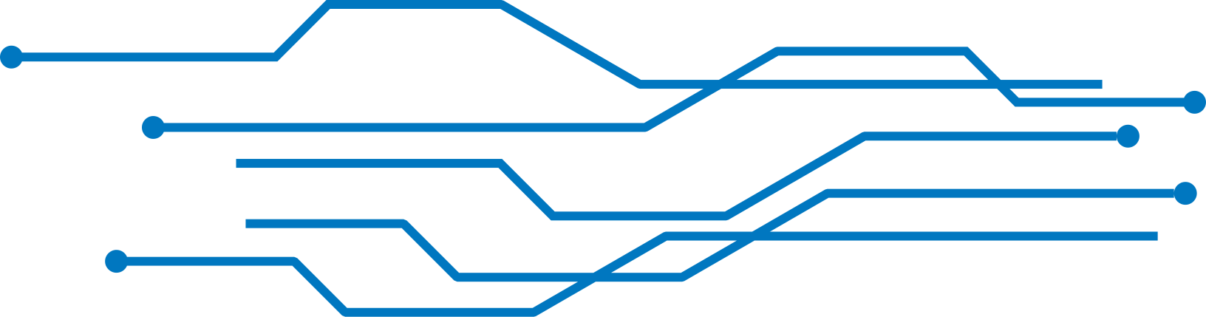
Project Objectives
Automation
Streamline calculations for efficiency and accuracy
Programming
Utilize arrays and control structures effectively
User Interface
Design a friendly menu for navigation

Slide 4


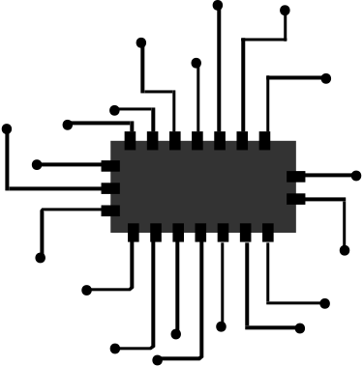
System Requirements
Essential Hardware and Software for Optimal Performance
To effectively run the Matrix Operations Tool, your system should meet these minimum requirements: an Intel i3 processor or higher, at least 4GB of RAM, and an operating system of either Windows or Linux. Additionally, the tool needs a GCC compiler to execute the C programming code seamlessly.

Slide 5
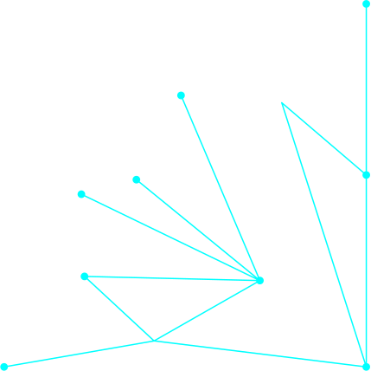



Step-by-Step Algorithm Overview
1️⃣ Start program
2️⃣ Display menu:
1 → Add 2 → Subtract 3 → Multiply
4 → Transpose 5 → Row Sum 6 → Column Sum 7 → Exit
3️⃣ Read user choice
4️⃣ If choice = 7: Display “Exit” → Stop
5️⃣ If Add/Sub:
• Read rows & cols (r, c)
• Read matrices A & B
• Perform A ± B
• Display result
6️⃣ If Multiply:
• Read sizes A(r₁, c₁), B(r₂, c₂)
• If c₁ ≠ r₂ → print “Can’t multiply”
• Else multiply A × B → Display result
7️⃣ If Transpose / RowSum / ColSum:
• Read matrix A
• Perform respective operation → Display result
8️⃣ Return to menu and repeat

Slide 6


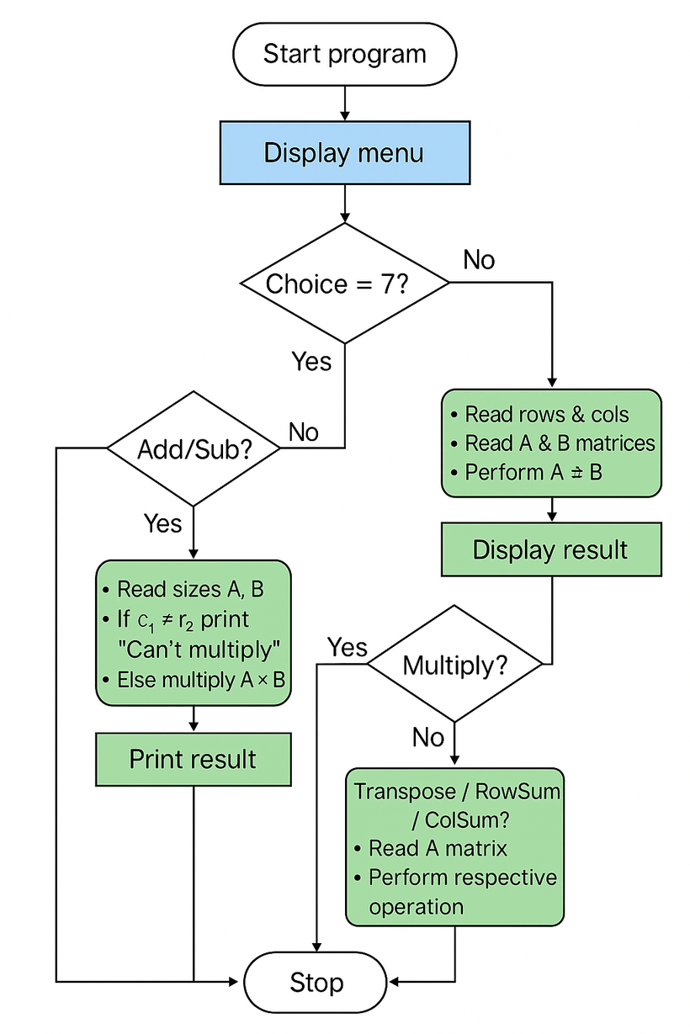


Flowchart Design
Visual representation of the system's workflow steps.

Slide 7
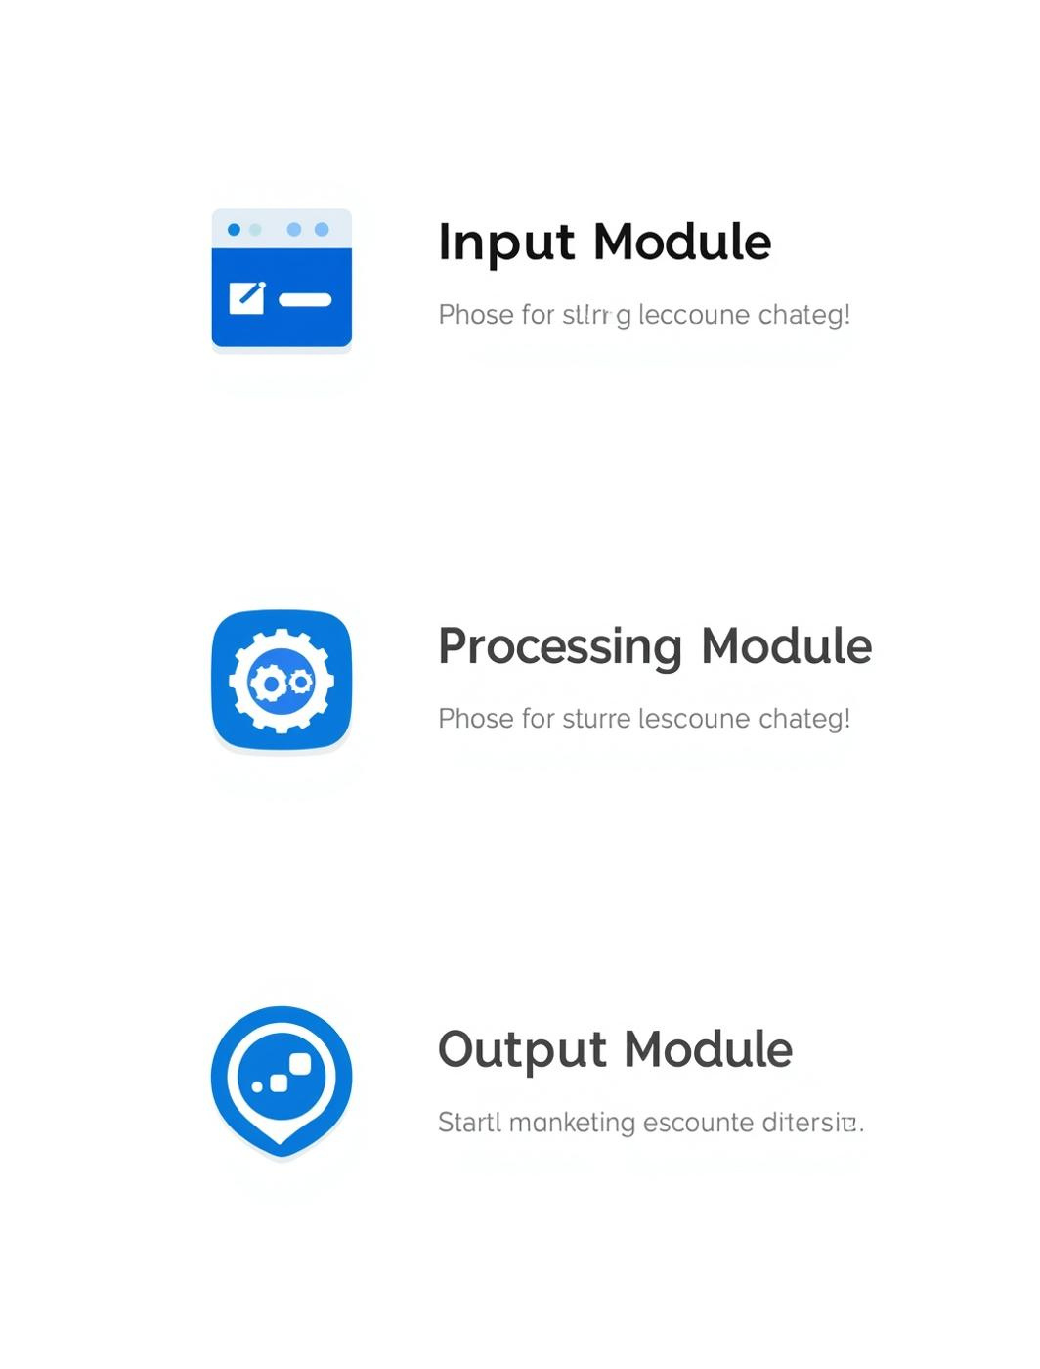
Module Description
Key Components for Matrix Operations and User Interaction
The Matrix Operations Tool consists of three main modules: the Input Module gathers user data, the Processing Module executes calculations, and the Output Module presents results clearly. This modular design promotes clarity, enhances user experience, and maintains the program’s functionality, allowing for easy updates and improvements in the future.

Slide 8
⚙️ Implementation of Code Logic — Code Structure
Modular Design:
Separate functions handle specific tasks for clarity and reusability.
Main Components:
main() → Menu, user input, operation selection
readMatrix(), printMatrix() → Input / Output
addMatrices(), subMatrices(), mulMatrices() → Core math logic
transposeMatrix(), sumOfRows(), sumOfColumns() → Extra tools
Flow:
Menu → Read Choice → Validate → Perform Operation → Display Result → Repeat
Data Used:
2D arrays A, B, R (size ≤ MAX × MAX)
Key Feature:
Clean modular structure, simple logic, easy maintenance

Slide 9
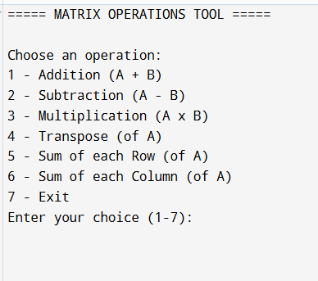
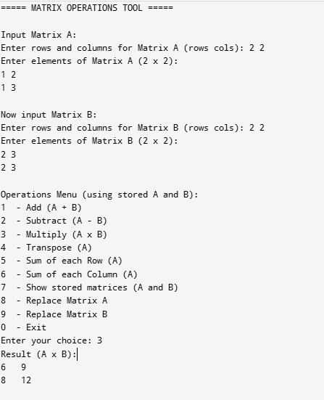
Sample Output of Matrix Operations

Slide 10

Results
Evaluating the Effectiveness of the Matrix Operations Tool
The Matrix Operations Tool has demonstrated accurate results and efficient processing capabilities. Users can perform basic matrix computations interactively, showcasing the importance of programming logic and user-friendly design. This tool not only enhances computational speed but also reduces human error, making it a valuable asset for academic purposes.

Slide 11

Conclusion & Future Enhancements
Reflecting on achievements and potential advancements in matrix operations
This project has successfully achieved its goal of automating matrix calculations, enhancing both speed and accuracy. Looking ahead, future enhancements may include the addition of determinant and inverse calculations, as well as the ability to save results to files, further broadening the tool's functionality.

Slide 12
References & Acknowledgements
Resources that supported the development of the matrix operations tool
This project benefited from a variety of resources including textbooks, online tutorials, and guidance from mentors. Special thanks to my teammates for their collaboration and insights, which were invaluable in refining the design and implementation of the matrix operations tool.

Slide 13


